Slide 1
Sentiment Analysis on Movie Review Data Using Machine Learning Approach
Team Binary Beast
Mohee Datta Gupta, Rohith R, Sridhar M

Slide 2
Analysis procedure - Text preprocessing
Dataset of movie reviews created using the source - github
2000 movie review posts - with equal positive and negative reviews
Text preprocessing:
URL removal
Bracket and number removal
Tokenization
Omitting punctuation
Case conversion
Omitting stop words
Stemming

Slide 3
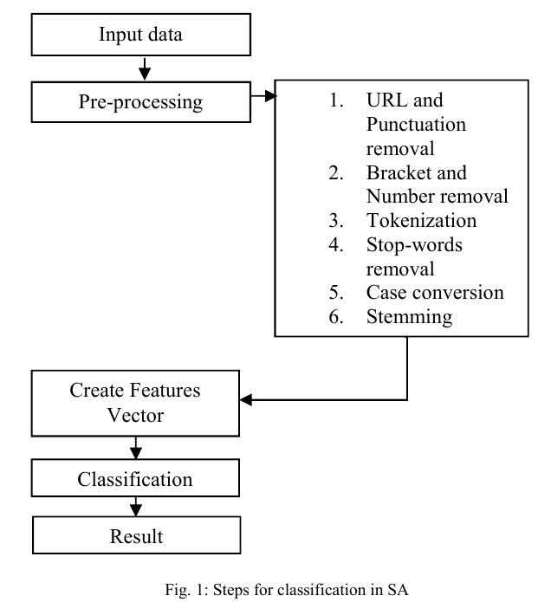
Analysis procedure

Slide 4
Analysis procedure - Feature Vector Creation
Classify each review as a positive or negative
Every review is considered as a document
Parts of Speech (PoS) tags are added to get more accurate sentiments
Positive and negative sentiments are maintained by respective sentiment scores
Every word has a feature
No. of features in the document gives us its dimmensionality

Slide 5
Considered Classifiers
Naive Bayes classifier
Bernoulli NB classifier
Multinomial NB classifier
SVM
Maximum entropy classifier
Decision Tree classifier

Slide 6
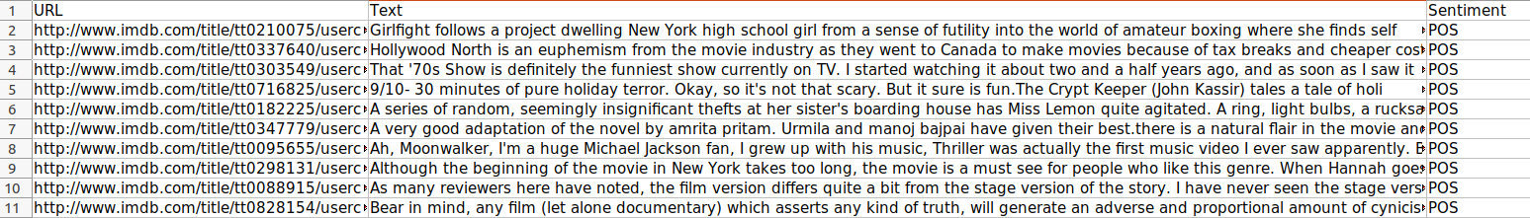
Dataset
The dataset has 3 columns : URL, Text, Sentiment
The URL is useless for our project and hence dropped immediately
The Text column has the movie review and will be pre-processed before using as the X_train
The Sentiment column stores POS for a positive review and NEG for a negative review which is converted to a binary before using as our Y_train.

Slide 7
Contributions Plan (Tentative)
Mohee Datta Gupta - Data Analysis, Naive Bayes, MNB
Rohith R - Decision Tree, SVM
Sridhar M - SVM, ME classifier

Slide 8
Tentative Weekly Work Execution Plan
Week | 1 (4th-10th Apr) | 2 (11th-17th Apr) | 3 (18th-23rd Apr)
Mohee | Figure out data pre-processing | Implementation of Naive Bayes & MNB | Concluding from results
Rohith | Implementation of Dec. Tree | Implementation of SVM & Dec. Tree | Comparing results from different methods
Sridhar | Implement Maximum entropy classifier & SVM | Implementation of SVM | Comparing results from different methods

Slide 9
Thank You!!

